Slide 1

Creating the vision for safety

Slide 2
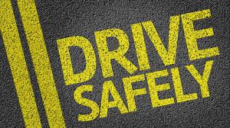
Road safety
In today's world road and transport has become an integral partof every human being. Every body is a road user in one shape or the other. The present transport system has minimized the distances but it has on the other hand increased the life risk. Every year road crashes result in loss of lakhs of lives and serious injuries to crores of people.
In India itself about eighty thousand people are killed in road crashes every year which is thirteen percent of the total fatality all over the world. Man behind the wheel plays an important role in most of the crashes. In most of the cases crashes occurs either due to carelessness or due to lack of road safety awarenessof the road user. Hence, road safety education is as essential as any other basic skills of survival.

Slide 3
Technical overview
Now a days road safety is a very important aspect
So in order to improve the road safety we had used the computer vision
By using the computer vision we can detect the facial expressions of a driver and warn him if he is going into a sleepy mode
By doing this we can avoid the some road accidents

Slide 4
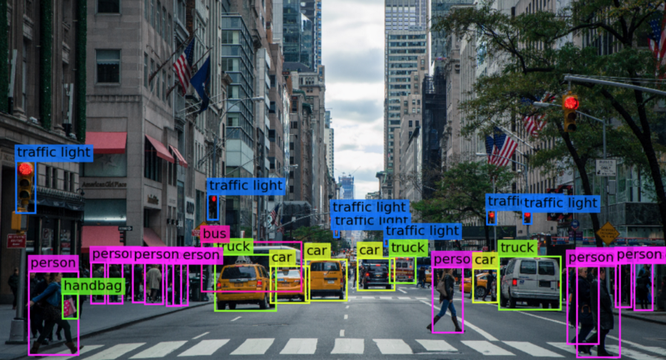
Computer vision
Computer vision is a field of computer science that focuses on enabling computers to identify and understand objects and people in images and videos. Like other types of AI, computer vision seeks to perform and automate tasks that replicate human capabilities.

Slide 5
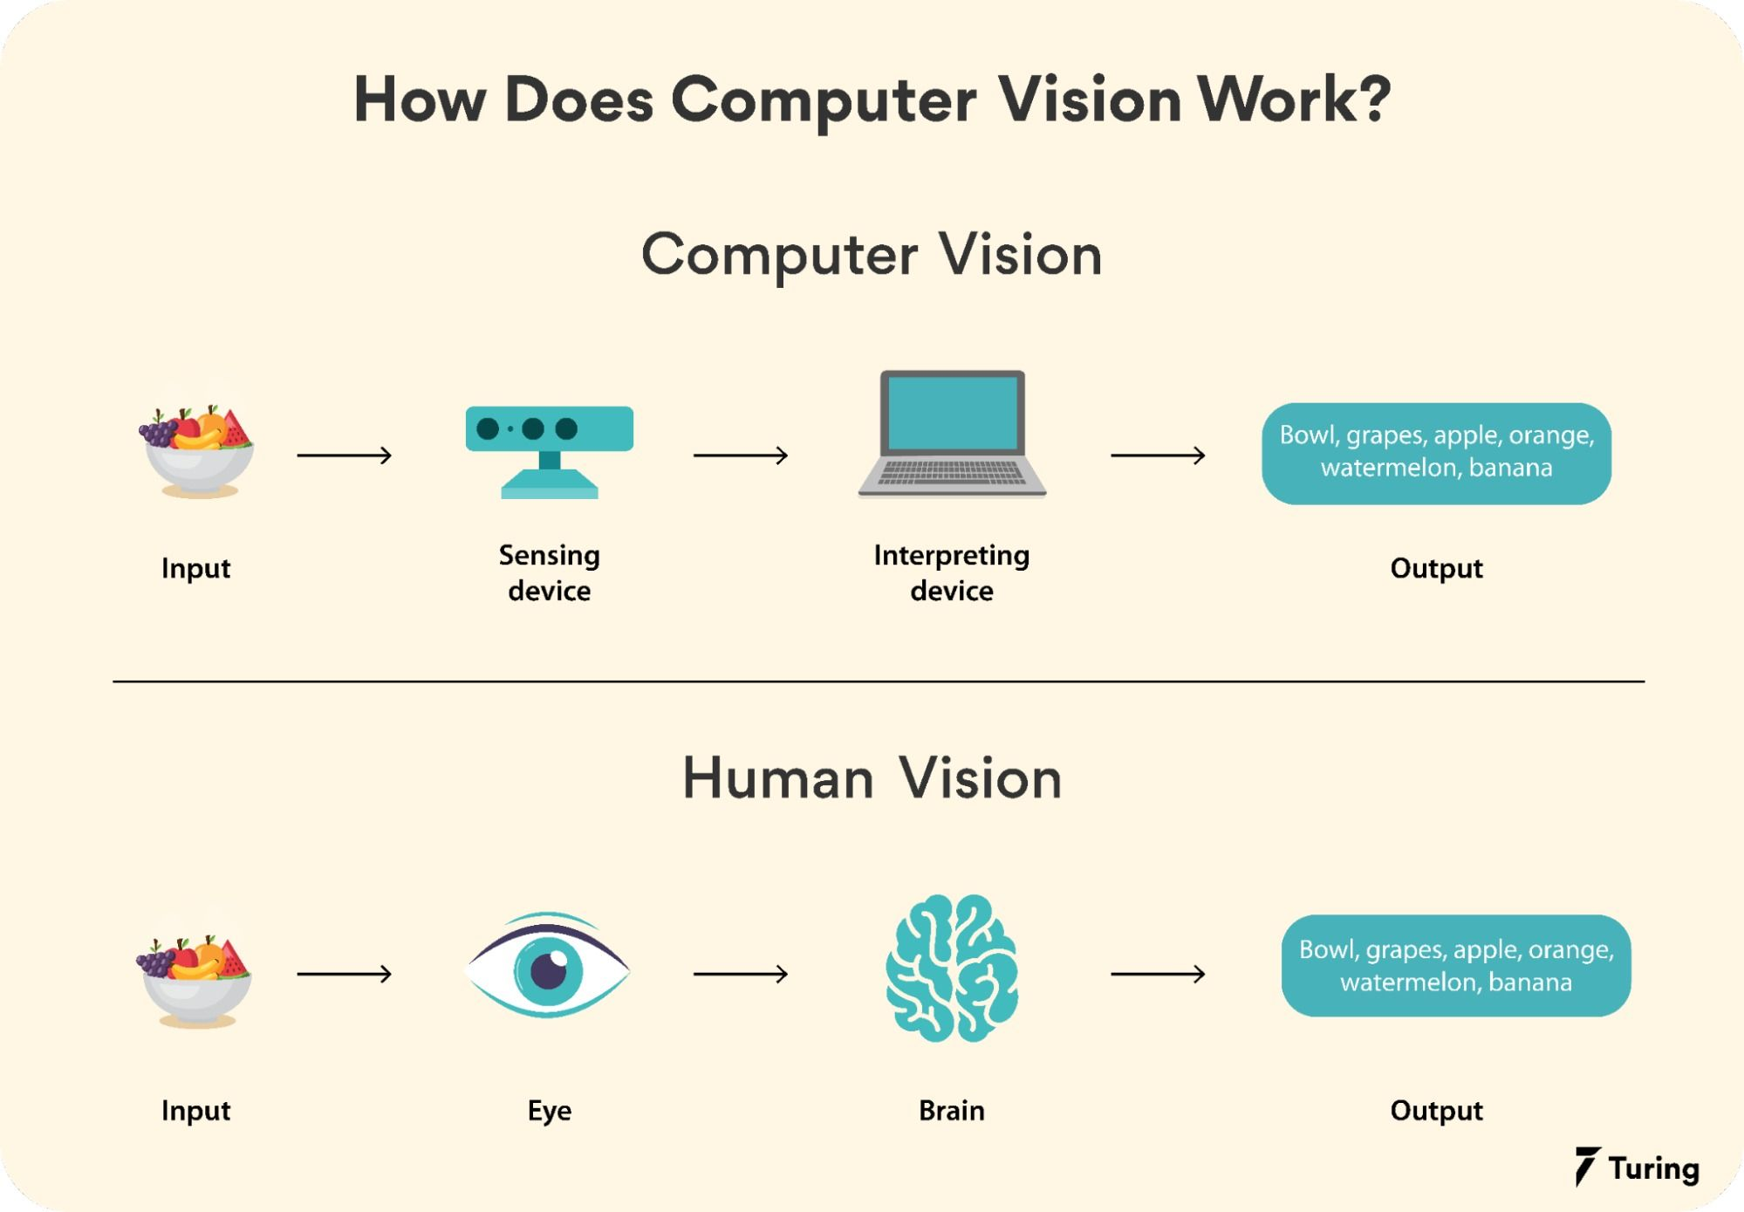
How computer vision works?
Computer vision applications use input from sensing devices, artificial intelligence, machine learning and deep learning to replicate the way the human vision system works.
Computer vision applications run on algorithms that are trained on massive amounts of visual data or images in the cloud. They recognize patterns in this visual data and use those patterns to determine the content of other images.

Slide 6
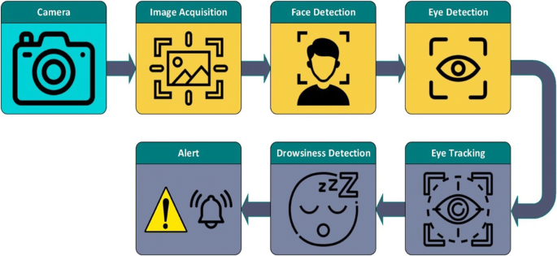
How an image is analyzed with computer vision?
A sensing device captures an image. The sensing device is often just a camera, but could be a video camera, medical imaging device or any other type of device that captures an image for analysis.
The image is then sent to an interpreting device. The interpreting device uses pattern recognition to break the image down, compare the patterns in the image against its library of known patterns and determine if any of the content in the image is a match. The pattern could be something general, like the appearance of a certain type of object or it could be based on unique identifiers such as facial features.
A user requests specific information about an image and the interpreting device provides the information requested based on its analysis of the image.

Slide 7
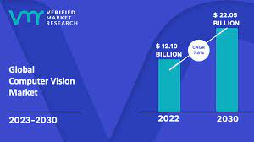
Market overview and future scope of computer vision
The Global Computer Vision market is anticipated to rise at a considerable rate during the forecast period, between 2023 and 2030. In 2022, the market is growing at a steady rate and with the rising adoption of strategies by key players, the market is expected to rise over the projected horizon.
The future of computer vision is expected to be brightand promising according to a blog post by NVIDIA,the integration of computer vision with AI,advancements in deep learnin models, and the growth of AI applications in various industries are some of the trends to watch out for

